Slide 1
CSE101-lec#12
Designing Structured Programs Introduction to Functions
©LPU CSE101 C Programming

Slide 2
Outline
Designing structured programs in C:
  Counter-controlled repetition (Range)
  Sentinel-controlled repetition (condition till specific symbol/ value is encountered)
  Top down design and stepwise refinement
Type conversion
Functions(prototype and definition)
©LPU CSE101 C Programming

Slide 3
Repetitions
The while loop repeats until the condition is true.
The condition to stop the repeated loop depends upon the output required
Condition
True
Repeated_Actions
False
©LPU CSE101 C Programming

Slide 4
Formulating Algorithms
(Counter-Controlled Repetition)
Counter-controlled repetition
  Loop repeated until counter reaches a certain value.
  Counter is a variable used to specify the number of times a set of statements should execute.
Example (class-averaging problem)
A class of ten students took a quiz. The marks for this quiz are available to you. Determine the class average on the quiz.
©LPU CSE101 C Programming

Slide 5
Class-averaging Problem
Pseudocode:
  Set total to zero
  Set grade counter to one
  while grade counter is less than or equal to ten
    Input the next grade
    Add the grade into the total
    Add one to the grade counter
  Set the class average to the total divided by
Ten or counter.
  Print the class average
©LPU CSE101 C Programming

Slide 6




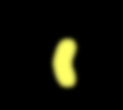



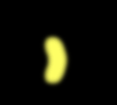

#include <stdio.h> int main()
{
int counter;
int grade, total, total = 0;
counter = 1;
//number
of grade
to be entered next
average;
//
//
initialize total initialize loop counter
// loop 10 times
while ( counter <= 10 ) {
printf( "%s", "Enter grade: "); scanf( "%d", &grade );
total = total + grade; counter = counter + 1;
} // end while average = total / 10;
// increment counter
printf( "Class average is %d\n", average );
}
©LPU CSE101 C Programming

Slide 7
Enter | grade: | 98
Enter | grade: | 76
Enter | grade: | 71
Enter | grade: | 87
Enter | grade: | 83
Enter | grade: | 90
Enter | grade: | 57
Enter | grade: | 79
Enter | grade: | 82
Enter | grade: | 94
Class average is 81
©LPU CSE101 C Programming

Slide 8
Formulating Algorithms with Top-Down, Stepwise Refinement
Reconsider class-averaging problem:
Develop a class-averaging program that will process an arbitrary number of grades each time the program is run.
  Unknown number of students.
  How will the program know when to end?
Use sentinel value
  Also called signal value, dummy value, or flag value
  Indicates “end of data entry.”
  Loop ends when user inputs the sentinel value
  Sentinel value chosen so it cannot be confused with a
regular input (such as -1 in this case)
©LPU CSE101 C Programming

Slide 9
Formulating Algorithms with Top-
Down, Stepwise Refinement
Top-down, stepwise refinement
  Begin with a pseudocode representation of the top:
Determine the class average for the quiz
  Divide top into smaller tasks and list them in order:
Initialize variables
Input, sum and count the quiz grades
Calculate and print the class average
©LPU CSE101 C Programming

Slide 10
Mostly programs have three phases:
  Initialization: initializes the program variables
  Processing: inputs data values and adjusts program
variables accordingly
  Termination: calculates and prints the final results
©LPU CSE101 C Programming

Slide 11
Formulating Algorithms with Top-
Down, Stepwise Refinement
Refine the initialization phase from Initialize
variables to:
Initialize total to zero Initialize counter to zero
Refine Input, sum and count the quiz grades to
Input the first grade
While the user has not as yet entered the sentinel Add this grade into the running total
Add one to the grade counter
Input the next grade
©LPU CSE101 C Programming

Slide 12
Formulating Algorithms with Top-
Down, Stepwise Refinement
Refine Calculate and print the class average to
If the counter is not equal to zero
Set the average to the total divided by the counter Print the average
else
Print “No grades were entered”
©LPU CSE101 C Programming

Slide 13
Refined Pseudocode for Class- averaging Problem
Pseudocode:
Initialize total to zero
Initialize counter to zero
Input the first grade
While the user has not as yet entered the sentinel
a. Add this grade into the running total
b.
c.
Add one to the grade counter
Input the next grade(possibly of the sentinel)
5. If the counter is not equal to zero
Set the average to the total divided by the counter
Print the average
Else
a.
Print “No grades were entered”
©LPU CSE101 C Programming

Slide 14




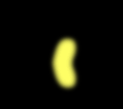




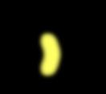

#include <stdio.h>
int main()
{
int counter, grade, total; float average;
total = 0; counter = 0;
printf("%s", "Enter grade, -1 to end:");
scanf("%d", &grade);
while ( grade != -1 ) { //Sentinel value = -1 total = total + grade;
counter = counter + 1;
printf( "%s", "Enter grade, -1 to end: " ); scanf("%d", &grade);
} //end while
if (counter != 0) {
average = (float) total/counter; //type conversion printf("Class average is %.2f\n", average);
} //end if
else {
puts("No grades were entered");
} //end else
}
©LPU CSE101 C Programming

Slide 15
Enter | grade, | -1 | to | end: | 75
Enter | grade, | -1 | to | end: | 94
Enter | grade, | -1 | to | end: | 97
Enter | grade, | -1 | to | end: | 88
Enter | grade, | -1 | to | end: | 70
Enter | grade, | -1 | to | end: | 64
Enter | grade, | -1 | to | end: | 83
Enter | grade, | -1 | to | end: | 89
Enter | grade, | -1 | to | end: | -1
Class average is 82.50
OR
Enter grade, -1 to end: -1
No grades were entered
©LPU CSE101 C Programming

Slide 16
Type Conversion
C evaluates arithmetic expressions only in which the data types of the operands are identical.
To ensure that operands are of same type, the compiler performs type conversion.
Converting between types can be :
  Implicitly (automatically)
  Explicitly (forced)
©LPU CSE101 C Programming

Slide 17
Implicit Conversion
If two operands are of different data types; the compiler performs an operation called implicit conversion on selected operands.
Example: in an expression containing the data types int and float, int operand is converted to float.
float average, total; int counter;
average = total/counter;
The copy of counter is made and converted to float, the calculation is performed and the result of floating-point division is assigned to average.
©LPU CSE101 C Programming

Slide 18
Order of converting type implicitly
long double
double float
unsigned long int long int signed int
int char
©LPU CSE101 C Programming

Slide 19
Explicit Conversion
Type is converted using unary type cast operator which temporary converts the operands.
Example: in an expression containing the data types int and float, int operand is converted to float.
float average, total;
int counter;
average = total/(float)counter;
The temporary floating-point copy of counter is created. The value stored in counter is still integer.
calculation is performed and the result of floating-point
division is assigned to average.
©LPU CSE101 C Programming

Slide 20
Cast operator is unary operator i.e. it takes only one operand.
It is formed by placing parentheses around the type name with operand.
Syntax
(type) operand;
©LPU CSE101 C Programming

Slide 21

ASCII Codes
©LPU CSE101 C Programming

Slide 22
#include<stdio.h>
int x=100;
void main()
{
int i=65;
printf("i=%c\n", i);
}
studentcompetitions.com
-Participation from student to sharpen their skills
©LPU CSE101 C Programming

Slide 23


©LPU CSE101 C Programming

Slide 24
Divide and Conquer
Best way to solve a problem is by dividing the
problem and solving it.
Divide and conquer
  Construct a program from smaller pieces or
components
    These smaller pieces are called modules
  Each module more manageable than the original program
©LPU CSE101 C Programming

Slide 25
Program Modules in C
Functions
  Modules in C are called functions.
  Programs combine user-defined functions with library
functions
    C standard library has a wide variety of functions for performing common mathematical calculations, string manipulations, character manipulations, input/output and many more.
    C standard library makes your job easier.
    Functions like printf(), scanf(), pow() are standard library functions.
    We can also write functions to define some specific task in a program and these functions are called user-defined functions.
©LPU CSE101 C Programming

Slide 26
Functions
Functions
  Modularize a program
  All variables defined inside functions are local variable.
  Known only in function defined.
  Parameters
    Functions have list of parameters.
    Communicate information between functions.
    Are also Local variables to that function.
©LPU CSE101 C Programming

Slide 27
Benefits of functions
Divide and conquer
  Manageable program development
Software reusability
  Use existing functions as building blocks for new programs
  Abstraction - hide internal details (library functions)
Avoid code repetition
©LPU CSE101 C Programming

Slide 28







Program Modules in C
Hierarchical boss function/worker function relationship.
main
worker1
worker2
worker3
worker4
worker5
©LPU CSE101 C Programming

Slide 29
Function Prototypes/ Declaration
Function prototype
  Function name
  Parameters – what the function takes in
  Return type – data type function returns (default int)
  Used to validate functions
  The function with the prototype
int square( int y);
    Takes in one int data [Parameter]
    Returns an int
Promotion rules and conversions
  Converting to lower types can lead to errors
©LPU CSE101 C Programming

Slide 30
Function Definitions
Function definition format
return-value-type function-name( parameter-list )
{
declarations and statements
}
Function-name: any valid identifier
Return-value-type: data type of the result (default int)
  void – indicates that the function returns nothing
Parameter-list: comma separated list, declares parameters
  A type must be listed explicitly for each parameter unless,
the parameter is of type void
int square( int y);
{
return y*y;
}
©LPU CSE101 C Programming

Slide 31
Function Definitions
Definitions and statements: function body (block)
  Variables can be defined inside blocks (can be nested)
  Functions can not be defined inside other functions
Returning control
  Nothing returned
    Execution until reaches right brace at the end of function.
  Something returned
    return expression;
©LPU CSE101 C Programming

Slide 32
Function Call
Function calls
  Invoking functions
    Provide function name and arguments (data)
    Function performs operations or manipulations
    Function returns results
  Function call analogy:
    Teacher asks student to complete task/assignment
      Student gets information, does task, returns result
      Information hiding: Teacher does not know details
square(5);
©LPU CSE101 C Programming

Slide 33
Example
main( )
{
printf ( "\nI am in main" ) ;
italy( ) ;
printf ( "\nI am finally back in main" ) ;
}
italy( )
{
printf ( "\nI am in italy" ) ;
brazil( ) ;
printf ( "\nI am back in italy" ) ;
}
brazil( )
{
printf ( "\nI am in brazil" ) ;
argentina( ) ;
}
argentina( )
{
printf ( "\nI am in argentina" ) ;
}

Slide 34
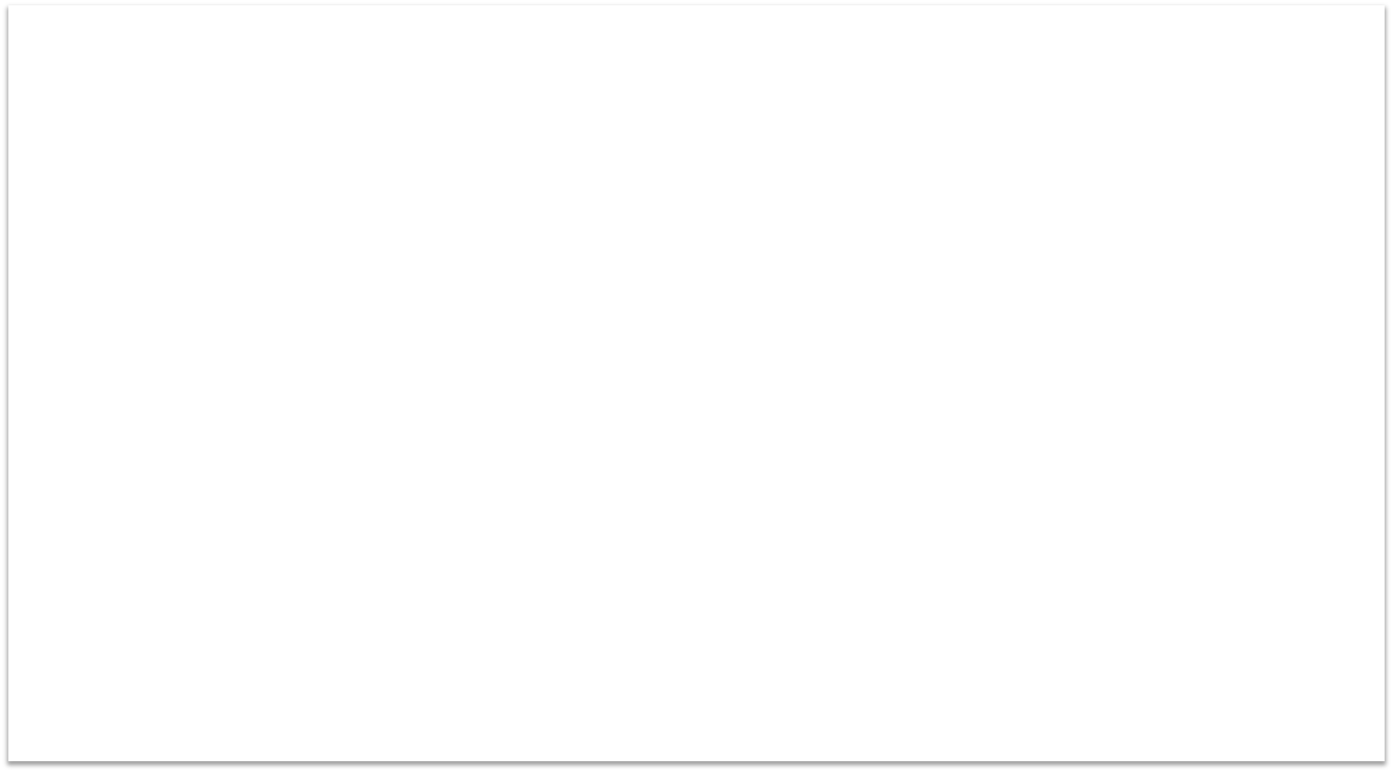

#include <stdio.h>
int square(int y); // function prototype
int main()
{
int x; //counter
for ( x = 1; x<= 10; ++x) {
printf( "%d", square(x)); //function call
} //end for
puts(" ");
} //end main
int square( int y) // function definition
{
return y * y;//returns the square of y as an int
}
1 4 9 16 25 36 49 64 81 100
©LPU CSE101 C Programming

Slide 35

Next Class: Math Library
Function
cse101@lpu.co.in
©LPU CSE101 C Programming

